Slide 1
Cardiac Cycle
A (very) brief overview
By Edward Foo, Y4 Medical Student

Slide 2
Goals
Discuss cardiac cycle
Discuss mechanics of cardiac output and blood pressure
Discuss clinical significance of each (briefly)
Address questions

Slide 3
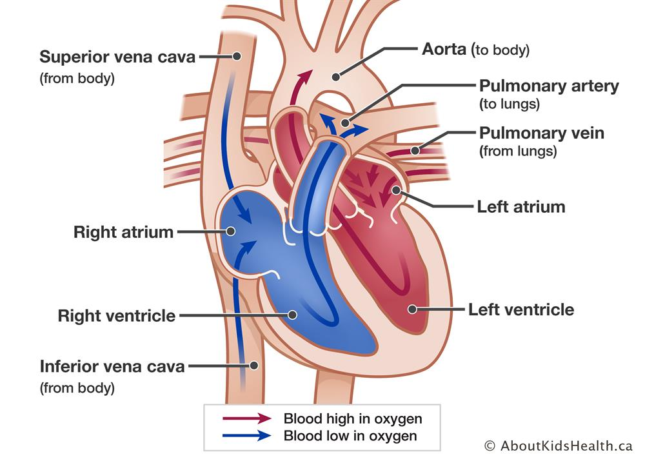

Slide 4
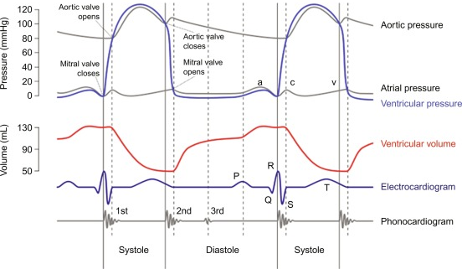
Remember – electrical signals precede contraction!

Slide 5
Cardiac Output and Blood Pressure
Cardiac Output = Heart Rate x Stroke Volume
Blood Pressure = Cardiac Output x Systemic Vascular Resistance

Slide 6
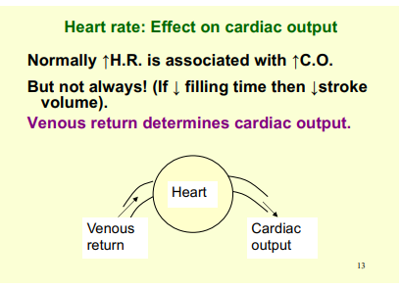
From Professor Evans’ lecture

Slide 7
Stroke Volume
Dependent on:
Contractility – the force of contraction
End diastolic volume – the degree of ventricular filling

Slide 8
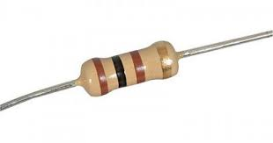
Afterload
Peripheral resistance to blood flow out of heart
Dependent on blood vessel diameter
- vasoconstriction or vasodilatation
Blood Pressure = Cardiac Output x Systemic Vascular Resistance
thus
Cardiac output = Blood Pressure / Systemic vascular resistance

Slide 9
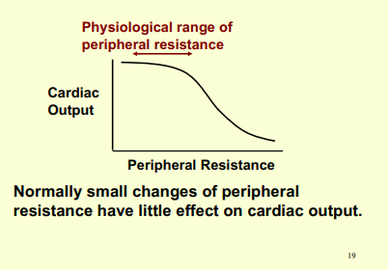
From Professor Evans’ lecture

Slide 10
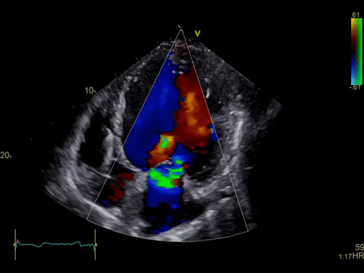
Ejection Fraction
% of volume of Left Ventricle pumped out
Varies with metabolic demand: resting 55-60%, exercise >80%
Considered low if ≤40%

Slide 11
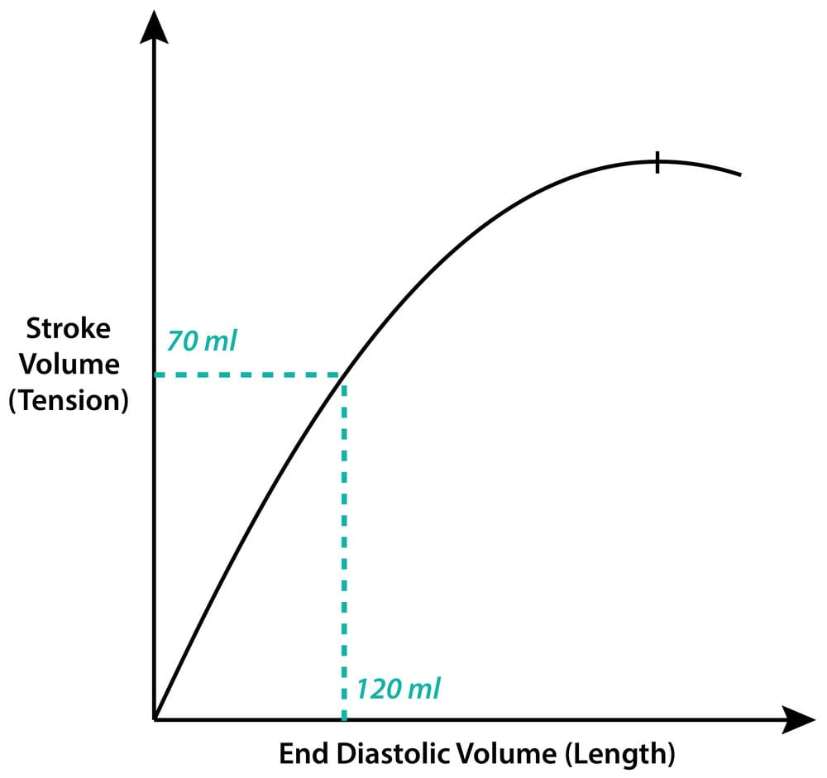
Frank-Starling Mechanism
The higher the EDV,
The higher the stroke volume!
Helpful in ensuring heart can deal with variations in
venous return
Congestive heart failure

Slide 12
Stroke volume ↓
End systolic volume ↑
CO normalises
End diastolic volume ↑
Stroke volume ↑
Drop in SV on one cardiac cycle can (in theory) be compensated by the subsequent cycle!

Slide 13
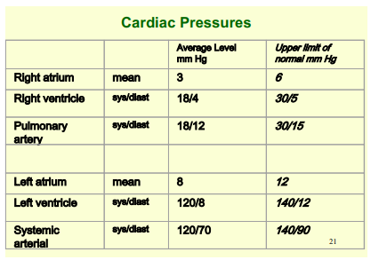
From Professor Evans’ lecture

Slide 14
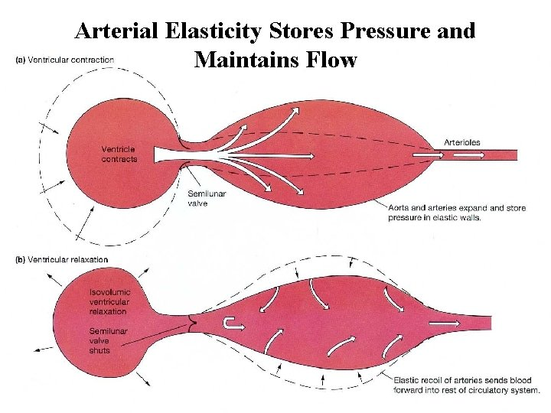

Slide 15

Questions?

