Slide 1
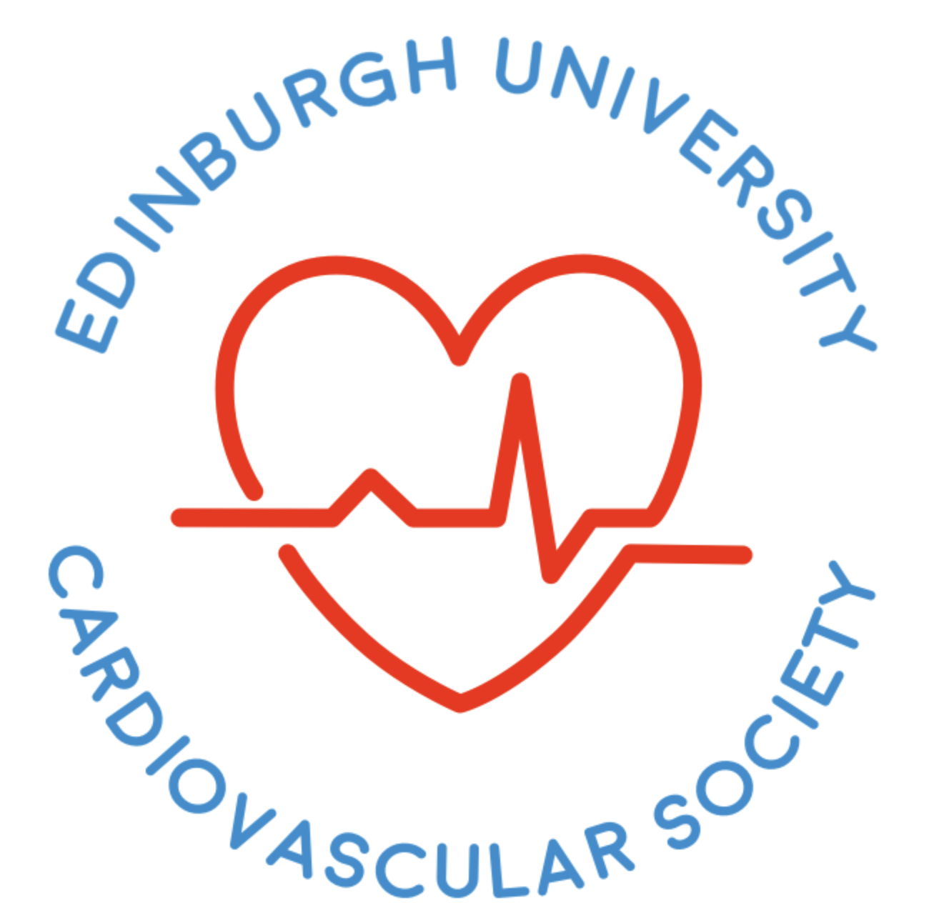
Year 1 Cardio Revision
Overview:
  Cardiovascular disease
    Types
  Atherosclerosis
  Myocardial Infarction
  ECG (STEMI vs NSTEMI)

Slide 2
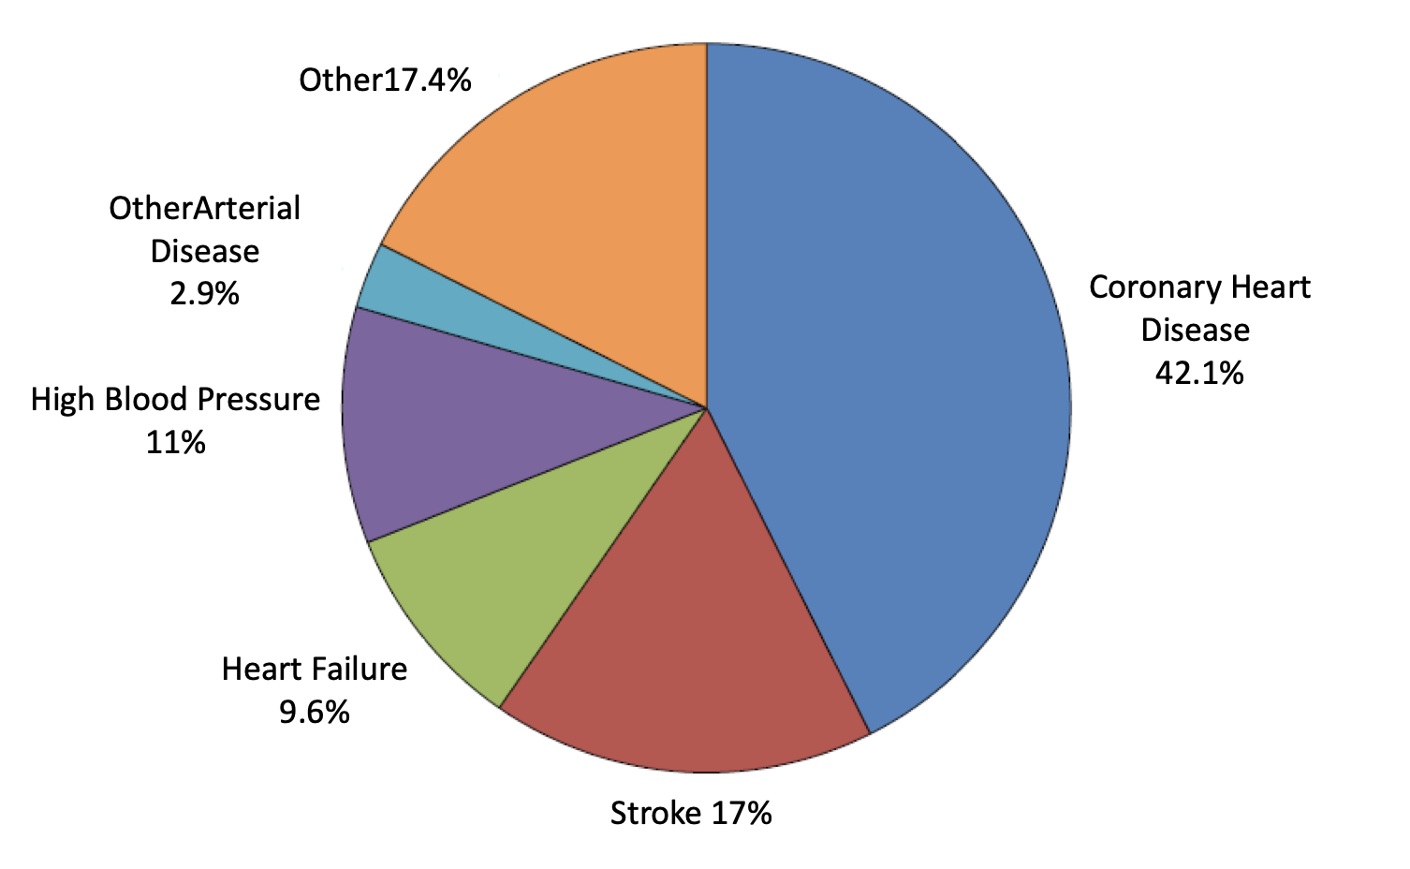
Cardiovascular Disease
General term for conditions affecting the heart or blood vessels
No.1 cause of death globally (~31% of total deaths in the world)
The two main CVS-related conditions that make up the majority of these deaths are:
  Myocardial infarction
  Cerebrovascular accidents (i.e. strokes)
Deaths Attributable to CVD; Derived from AHA Statistical Update 2021

Slide 3
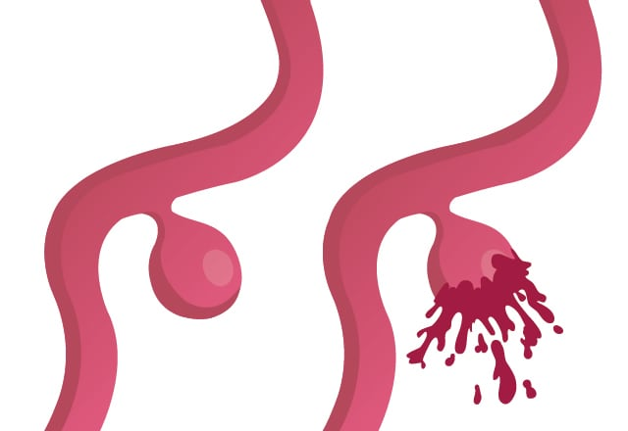
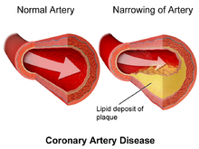
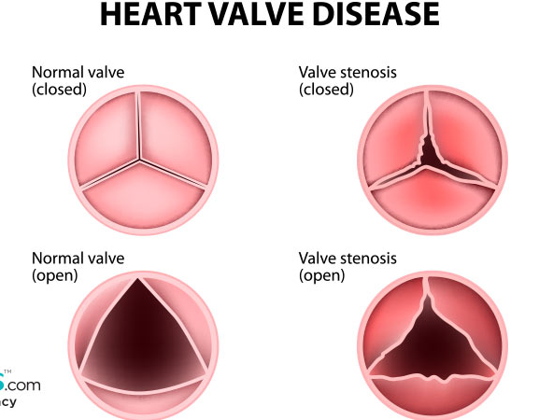
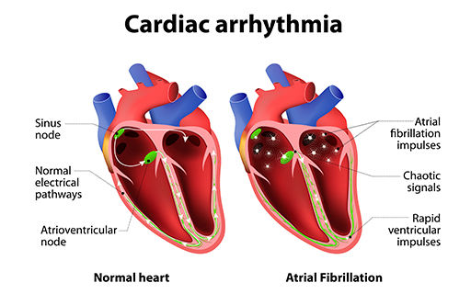
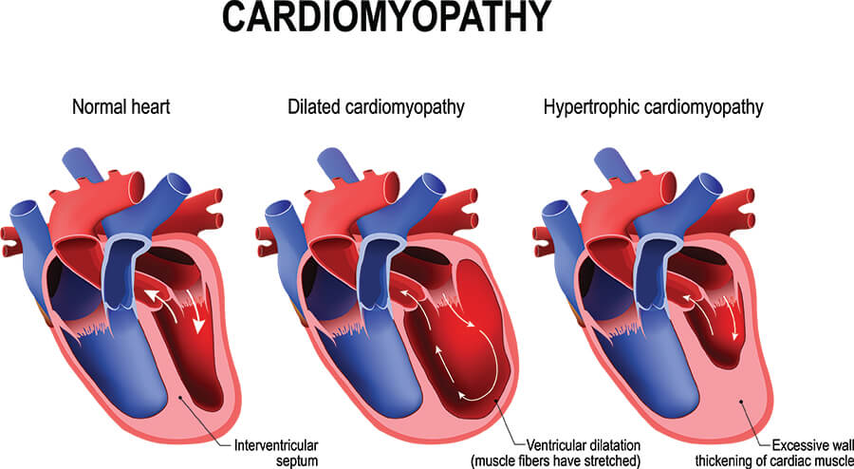
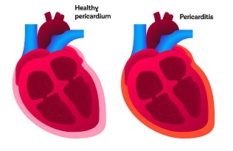
Types of cardiovascular diseases:
Coronary artery disease
  Build of of fatty deposits in the arteries that supply heart -> less blood is being delivered
Aneurysmal arterial disease
  Localised, permanent dilatation of a blood vessel
  Complication: rupture of the aneurysm (life-threatening)
Valve disease
  Valves don’t work properly – can cause backwards flow or restriction of blood flow
Cardiac Arrythmia
  Disorganised electrical signalling
Heart Failure
  Inability of the heart to pump sufficient blood to satisfy metabolic demands
Cardiomyopathy
  General term for a pathology in cardiac muscles (e.g. thickening of the myocardium)
Pericarditis
  Inflammation of the protective sac that surrounds the heart
Notes:
Some patients are asymptomatic – but some patients feel a ‘heart beat’ in aneurysms
Rupture is life-threatening therefore screening is important
Cardiomyopathy – one of the most common reasons why young patients die; like sports players

Slide 4
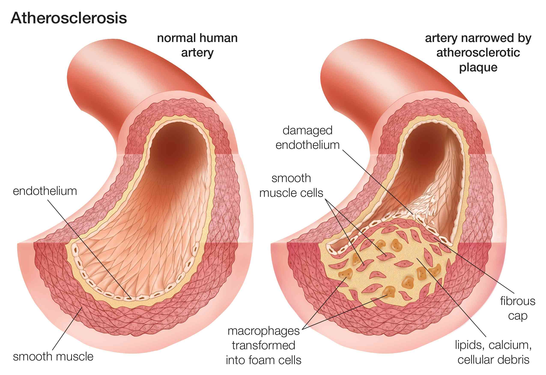
Atherosclerosis
Simple definition: the blockage and narrowing of arteries
  More detailed definition: slowly progressing, pathological process involving the intima and media of large- and medium-sized arteries which leads to the formation of focal lesions (plaques) containing lipid material and fibrous tissue
Symptoms depend on the site of the lesion
Risk Factors for atherosclerosis:
  hypertension
  hyperglycaemia
  lifestyle factors
  family history of cardiovascular disease
  poor fitness
  obesity
  insulin resistance
  kidney disease
  dyslipidaemia

Slide 5
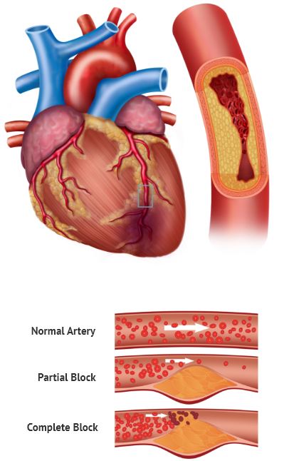
Myocardial Infarction
What is it?
  An area of necrosis in the heart muscle resulting from a (usually sudden) reduction in the coronary blood supply.
Myocardial ischaemia – what’s the difference?
  Ischaemia refers to the decreased volume of perfusion whereas infarction is the cellular response to the lack of perfusion
  Discomfort rather than pain; often felt during exertion
  It can be relieved by rest (<5 minutes)
  Emotions can exacerbate and precipitate symptoms

Slide 6
Risk Factors for MI
Hypertension
Atrial fibrillation
  Irregular, often abnormally fast heart rate
Diabetes
  High glucose levels can damage blood vessels and nerves that control heart
BMI (>35)
Smoking
  Chemicals from the smoke can cause blood to thicken and form clots inside arteries and veins
  Also has direct damage to blood vessel
Socioeconomic status

Slide 7
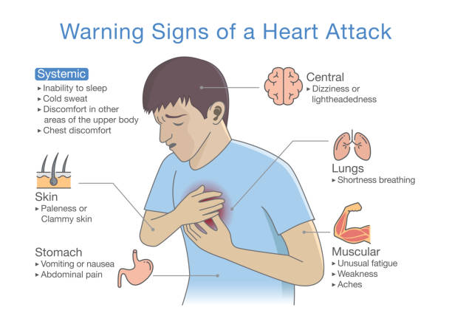
Signs and Symptoms of MI
Central crushing chest pain
Lightheadedness/Dizziness
Tightness in the chest
Nausea
Difficulty breathing
Inability to sleep
Clammy/sweat

Slide 8
Diagnosis of MI
Clinical history (i.e. family history, past medical history, presenting symptoms at the clinic)
ECG changes
Checking blood markers such as troponin levels
  Rise in troponin levels
  Troponin concentration of >0.40 ng/ml usually indicates MI

Slide 9
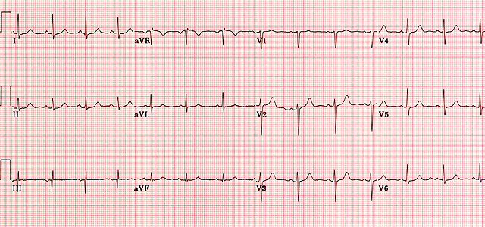
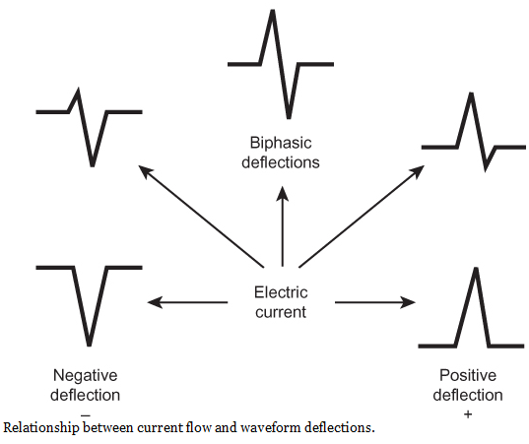
Electrocardiogram (ECG)
A test which monitor the activity of the heart
What happens?
  Electrical impulse (wave of depolarization) are picked up by placing electrodes on patient
  The voltage change is sensed by measuring the current change
  If electrical impulse travels towards the electrode, this results in a positive deflection (depolarization)
  If the electrical impulse travels away from the electrode, this results in a negative deflection (repolarization)

Slide 10
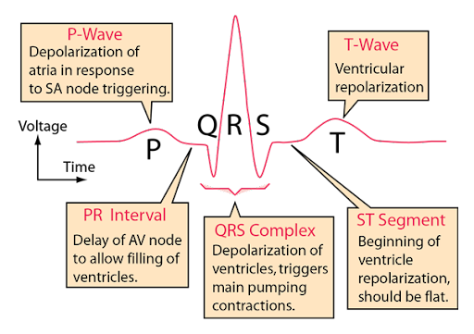
3 main distinct waves are produced during cardiac cycle:
P-wave: atrial depolarization
  When the atria are full of blood, the sinoatrial node creates an action potential which spreads throughout the atria causing it to depolarize
QRS complex: ventricular depolarization
  Firing of the action of atrioventricular node
  Q – depolarization of the interventricular septum
  R – depolarization of the main mass of the ventricles
  S – last phase of ventricular depolarization at the base of the heart
T- wave: ventricular repolarization
  Immediately before ventricular relaxation

Slide 11
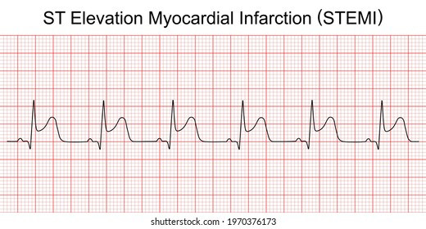

Slide 12
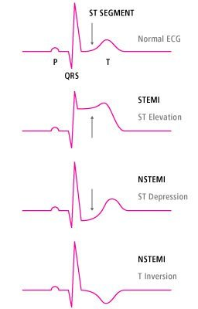
STEMI vs NSTEMI
ST-elevation MI
  Elevation of the blood markers + ST elevation
  worst one – requires prompt revascularization
    Complete blockage of coronary artery
Non ST-elevation MI
  Elevation of the blood markers but no ST-elevation seen on ECG tracing
  Maybe less serious as artery may only by partially blocked – only a small section of the heart is affected

Slide 13
Questions?

