Slide 1
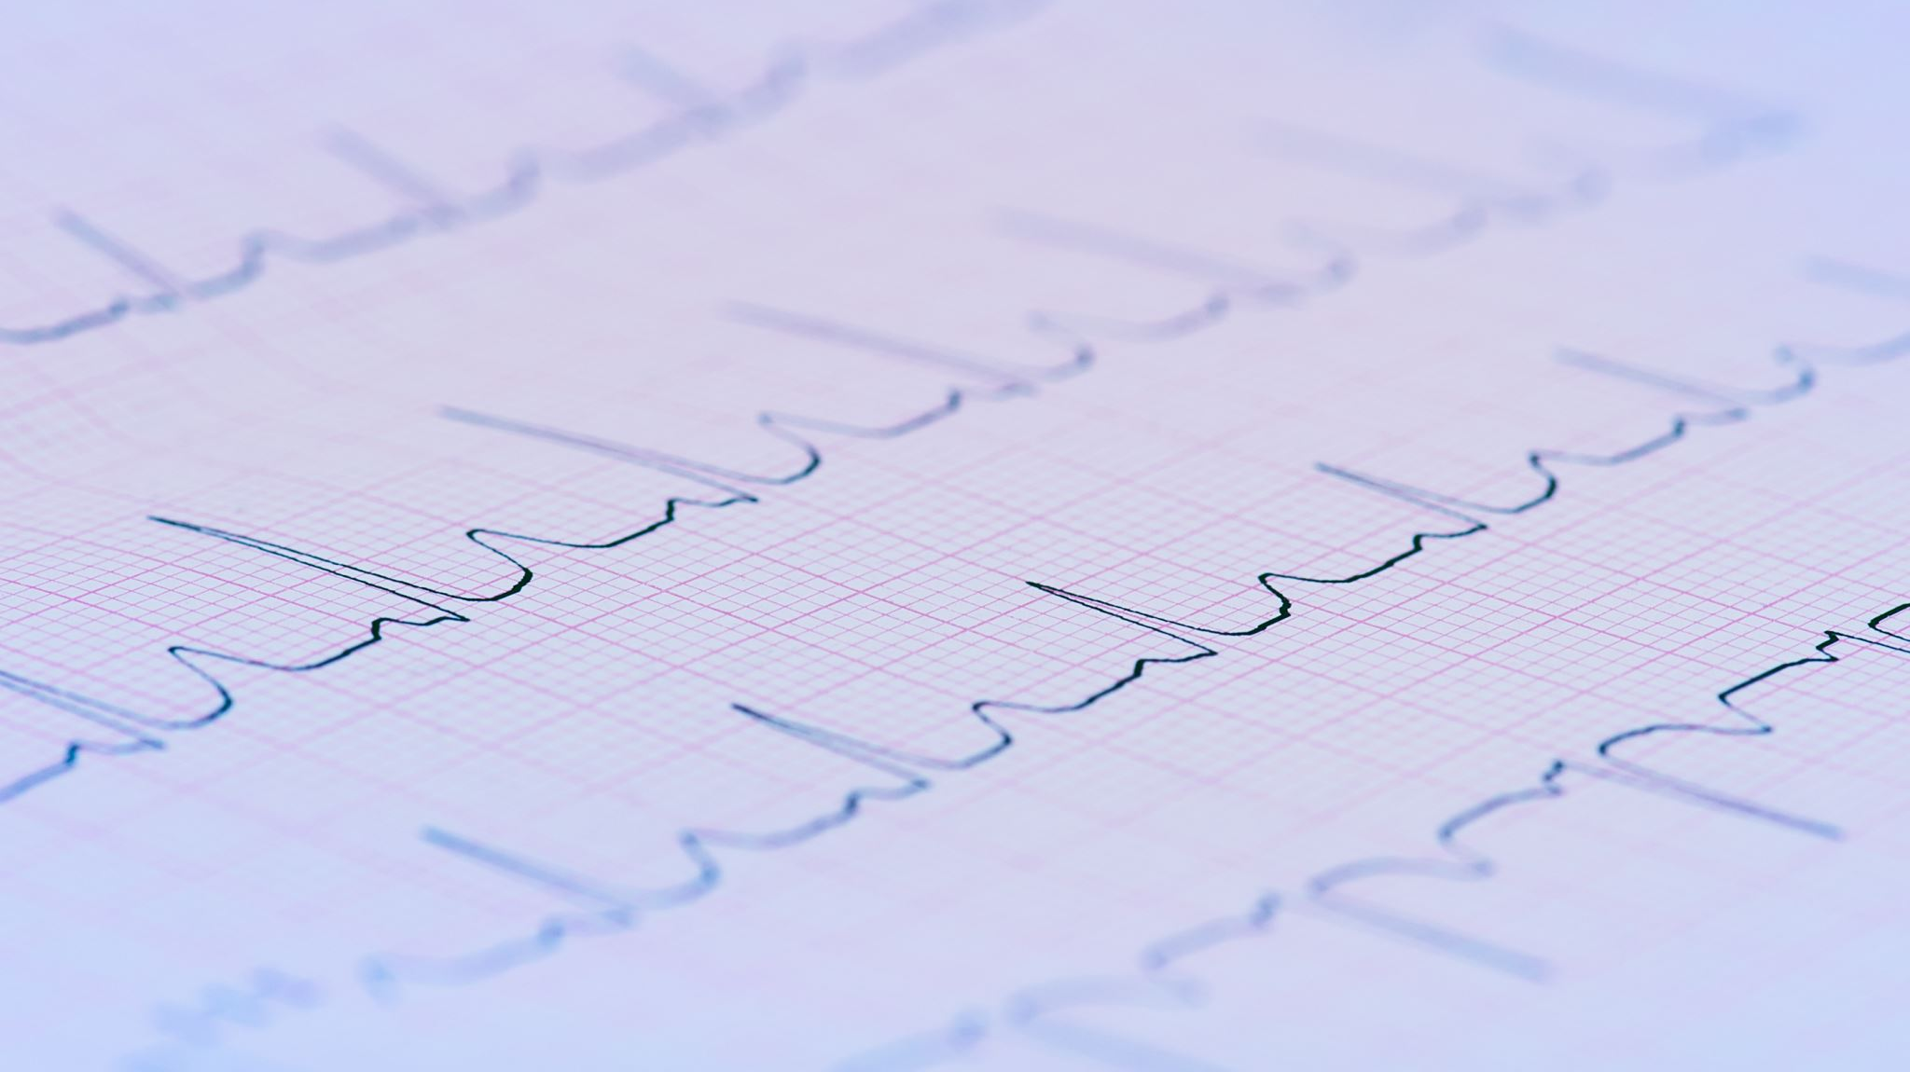
Year 1 Cardiology Tutorial
Semester 1
Practise Questions

Slide 2
Which of the following is not correct about arteries?
Small vessel diameter
Thick muscle walls
Less elastic tissue
Do not have valves

Slide 3
Which of the following is true for a patient diagnosed with oedema?
They will have low hydrostatic pressure in capillaries and this can lead to heart failure
They will have high oncotic pressure in capillaries and this can lead to losing proteins
They will have high hydrostatic pressure and this can be due to incompetent vein valves
They will have decreased capillary permeability

Slide 4
Which part of the heart produces electronic signals which can be picked up by ECGs?
Sino-atrial Node

Slide 5
At which point in the cardiac cycle does the semilunar valve shut?
At atrial filling
At ventricular filling
After atrial systole
After ventricular systole

Slide 6
An increased preload will lead to which of the following?
Increased cardiac output
Decreased stroke volume
Decreased cardiac output
No change to stroke volume

Slide 7
Which of the following is not correct about atherosclerosis?
It is the blockage and narrowing of the arteries caused by lipid deposits and fibrous tissue
It is a fast process which involves the tunica intima and media
Risk factors include diabetes, high blood pressure and high blood sugar
The resulting symptoms are dependent on the site of the lesion

Slide 8
Which of the following is correct about myocardial ischaemia?
Physical activity can exacerbate symptoms
It is the necrosis of the cell following lack of perfusion
Symptoms persists even after rest
Thickening of heart muscles occur

Slide 9
What troponin level indicates myocardial infarction?
0.40 ng/ml

Slide 10
What happens in the QRS complex?
Ventricular repolarisation
Depolarisation of the ventricles, precipitating main pumping contractions
Depolarisation of the atria in response to SA node stimulation
Delay of AV node to allow filling of ventricles

Slide 11
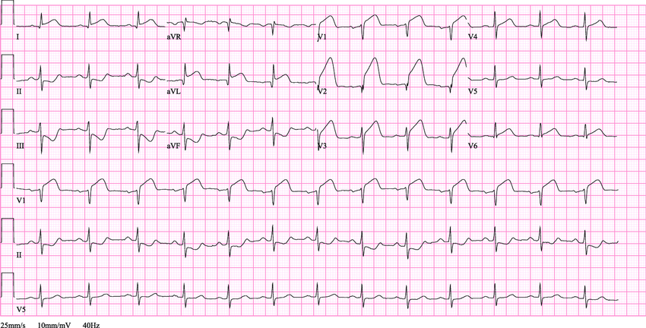
What does this ECG tracing show us?
Normal
NSTEMI
Ventricular fibrillation
STEMI

